Slide 1

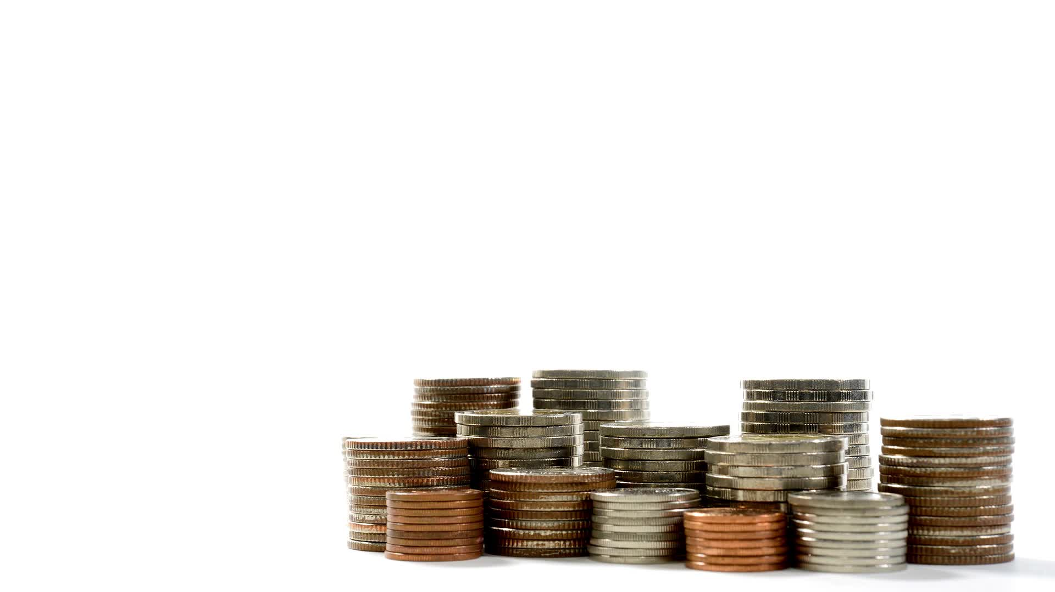



Reinforcement Learning

Slide 2
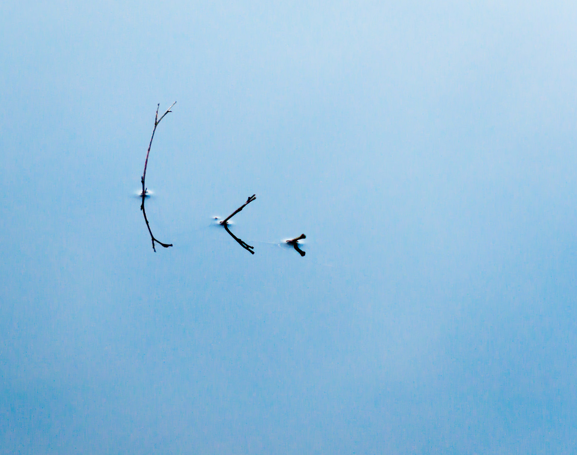









iman.mossavat@fontys.nl
  Working for Fontys since August 2022
  Enjoy learning “stuff”
…
  If you like this type of material join us at science and math club lunch meetings

Slide 3
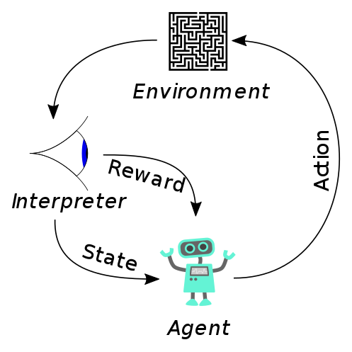
Supervised
Unsupervised
Reinforcement
Notes:
Did you already learn something about supervised/unsupervised?
Supervised learning: determining a pattern given example inputs with output labels (e.g. SVM, decision tree, regression).
Unsupervised learning: determining a pattern given example inputs without output labels (e.g. k-means, clustering).
Reinforcement learning: learning in a dynamic environment based on rewards and punishments (e.g. Q-learning, AlphaGo)

Slide 4

Agent (Action holder)
Environment
Uncertainty
Policy
Reward Signal

Slide 5
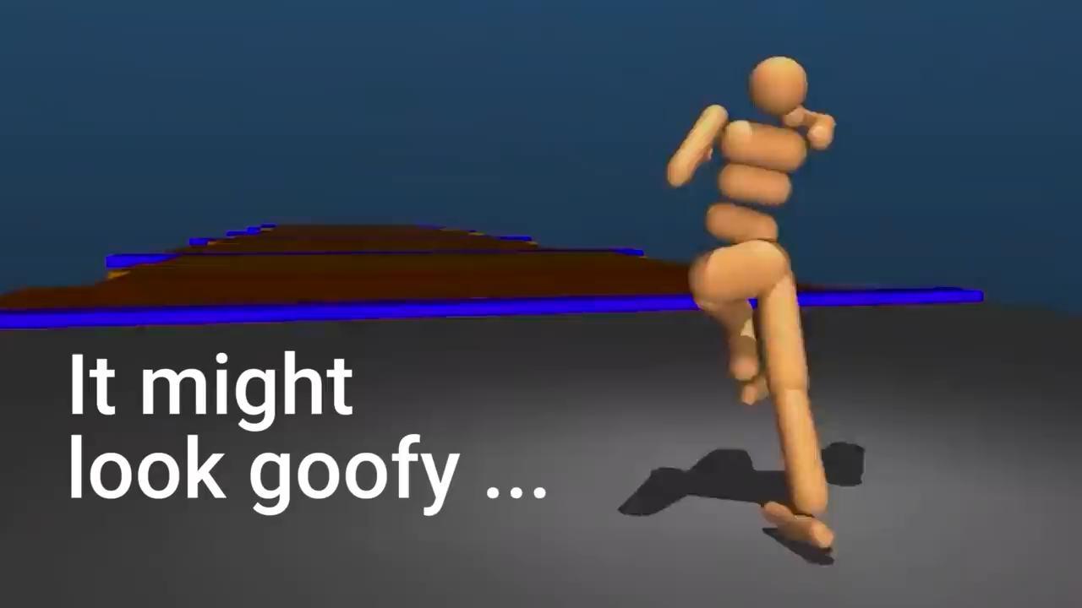
Notes:
https://www.youtube.com/watch?v=gn4nRCC9TwQ

Slide 6
An Explosion in RL Application
Reinforcement learning from human feedback (RLHF): use in ChatGPT
Accelerating fusion science through learned plasma control
Alpha Tensor: discovering new algorithms
References in RL - Theoretical background

Slide 7
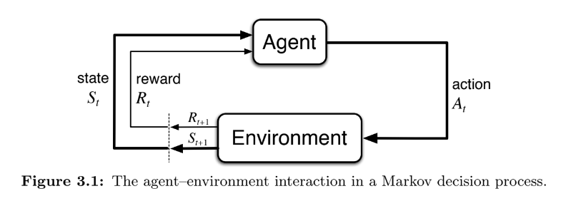
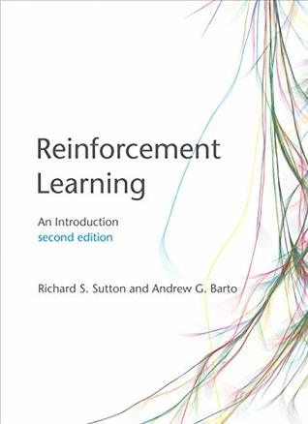
The Learning Loop
$$S_{0},A_{0}, R_{1},S_{1},A_{1},R_{2},S_{2},A_{2},…,R_{T},S_{T}$$
Sutton and Barto Book

Slide 8
Expected Future Reward or Quality Q is state and action dependent
If only your agent had a table with all the average reward for each state-action pair (or the quality)
 | action 1 | action 2 | action 3
state 1 | 0,11 | 0,51 | 0,94
state 2 | 0,09 | 0,09 | 0,11
state 3 | 0,96 | 0,10 | 0,30
state 4 | 0,14 | 0,21 | 0,34
Notes:
If only your agent had a table with all the average reward for each state-action pair (or the quality)
How do you know the reward?
You do an action, observe what the state and the reward is and update your table

Slide 9
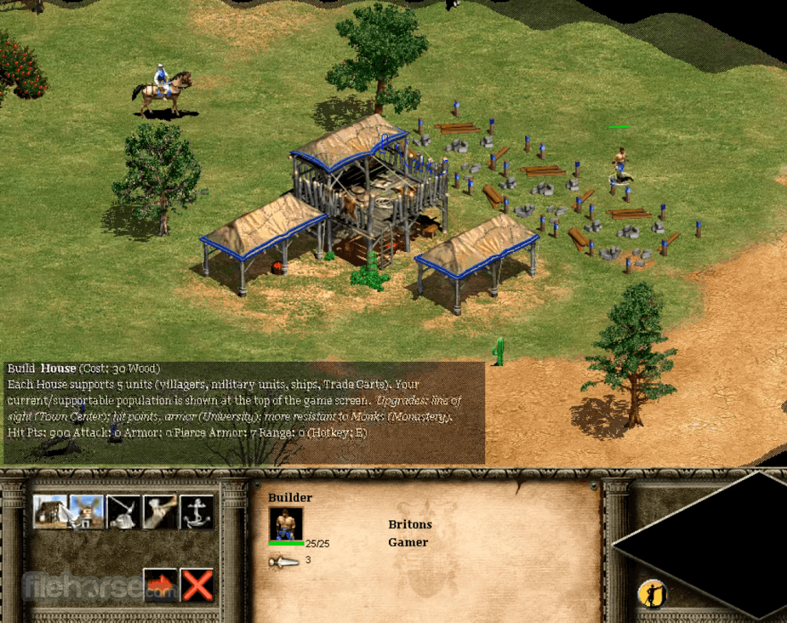
The agent does not initially have an overview, it must experience and find out

Slide 10
In typical scenarios we have to learn the Q function
 | action 1 | action 2 | action 3
state 1 | ? | ? | ?
state 2 | ? | ? | ?
state 3 | ? | ? | ?
state 4 | ? | ? | ?
Notes:
If only your agent had a table with all the average reward for each state-action pair (or the quality)
How do you know the reward?
You do an action, observe what the state and the reward is and update your table

Slide 11
Explore-Exploit Trade-offs
gather new information
leveraging existing knowledge.
Notes:
Mention that this trade-off exists in various domains of life, encompassing a wide range of decisions.
Explain the concept of explore-exploit trade-offs in decision-making.
Highlight that these trade-offs are recurrent and iterative in nature.

Slide 12
Use-cases
Restaurants: Choosing between a favorite place and a newly opened restaurant.
Music: Opting for a favorite album or exploring new music.
Social Lives: Balancing time with close circle friends and fostering new acquaintanceships.
Business: Deciding between running a proven ad with high click rates or trying new, untested ads.
Medicine: Weighing the best-known treatment against experimental options in clinical trials.
Notes:
Highlight the tension between running historically successful ads and trying new, potentially more effective ones.
There is dynamics in the landscape (new things to learn) for example for Ad

Slide 13
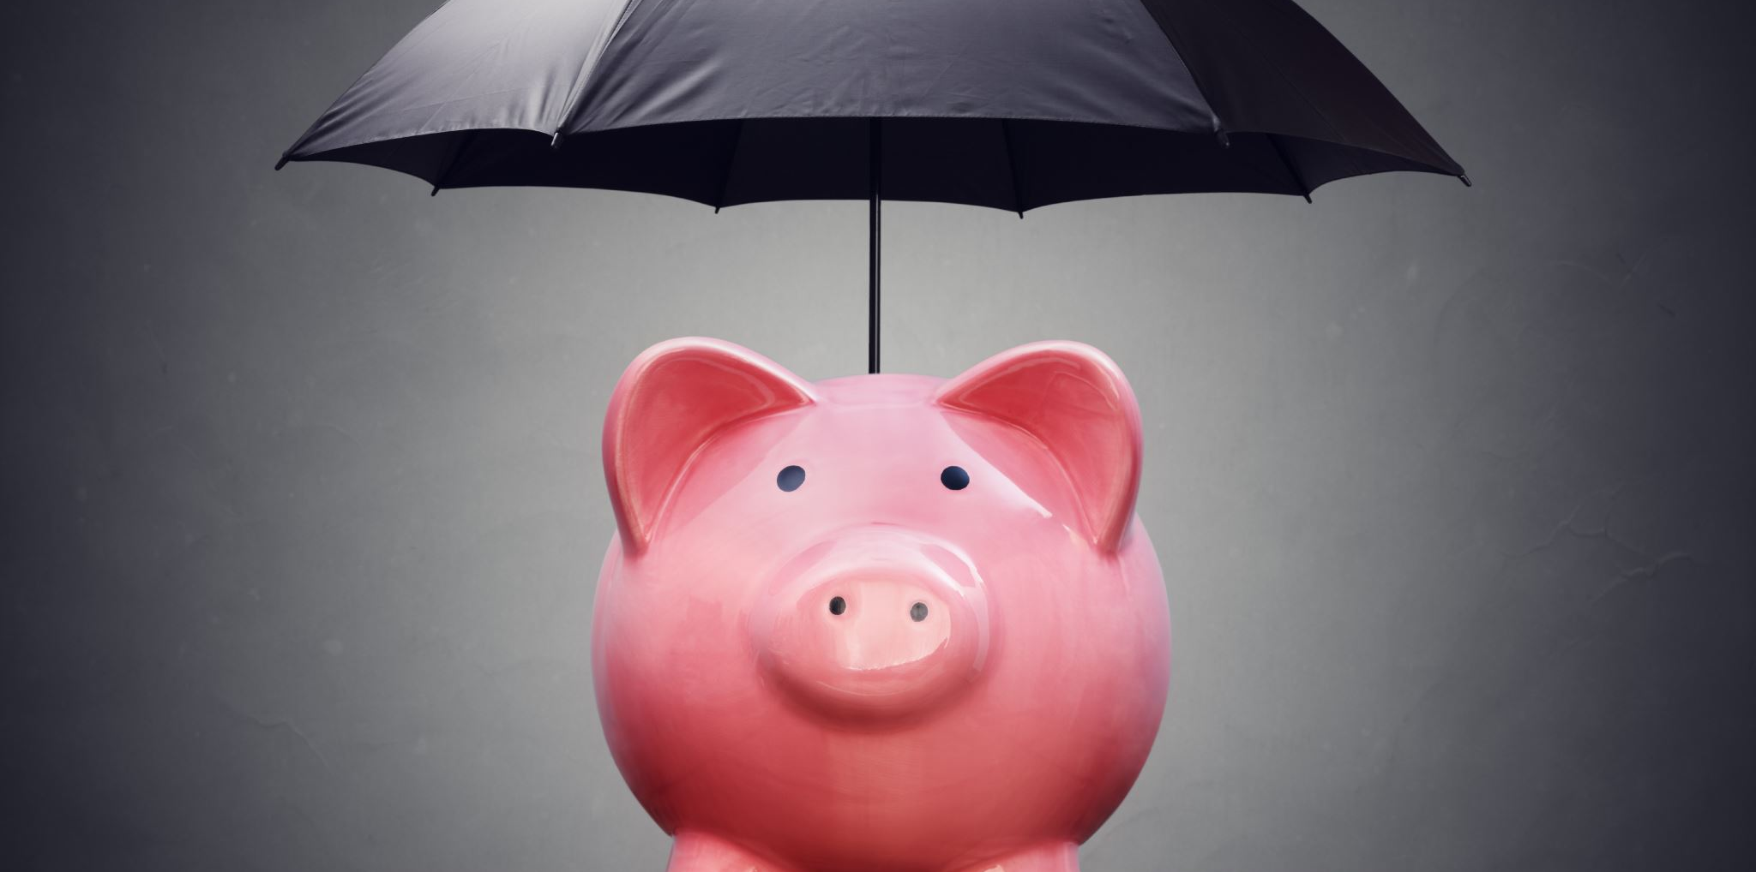
Don’t be Greedy
Or you will get stuck

Slide 14
exploration - exploitation
During the learning process, the agent needs to explore different actions and their outcomes to discover the optimal policy.
If the agent only chooses actions randomly, it may take a long time to converge to the optimal policy.
If the agent only chooses actions based on the current Q-values, it may get stuck in a suboptimal policy.
The epsilon-greedy strategy is used to balance between exploration and exploitation by choosing a random action with a small probability (epsilon) and choosing the action with the highest Q-value in the current state with probability (1-epsilon).

Slide 15
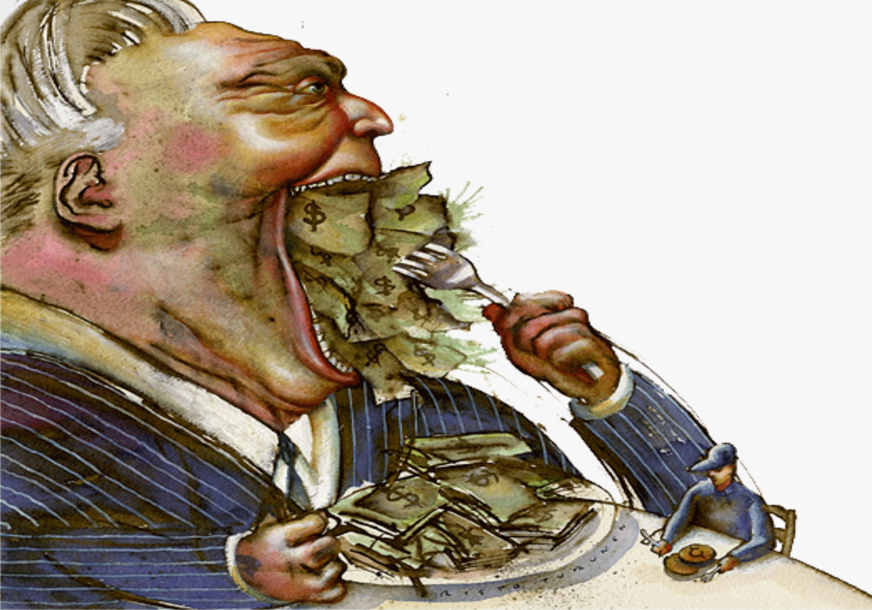


Hyper parameters
𝛆 (Epsilon, greediness)
𝛈/𝛂 (Eta/alpha, learning rate)
𝛄 (Gamma, discount)
Notes:
𝛆: a value of 0.1 will suffice
𝛄: Most of the time (0.9 or 0.99) to take all the next rewards into account, but a more “shortsighted” version n
𝛈/α: Most of the time a learning rate of 0.1 or 0.2 is fine

Slide 16
Gymnasium and Tabular Q-Learning Code

Slide 17
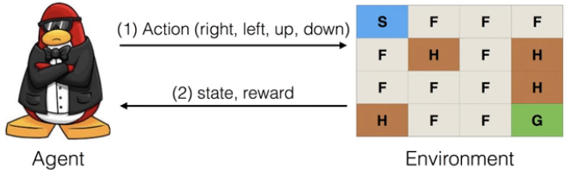
Example: Slippery Frozen Lake
Frozen Lake - Gymnasium Documentation (farama.org)
The agent does NOT have this overview initially, it must figure out the map by experimenting.
The agent starts at S and receives a reward when reaching G. If it falls into hole H the episode ends (and it may start over)
Notes:
Discuss the randomness in the MDP and transition probabilities for when the lake is slippery
Discuss that the agent does not have an explicit goal, it simply reacts to reward
Discuss that the agent does not have an overview, it experiments and figures out
Contrast this approach against the shortest path of Dijkstra

Slide 18
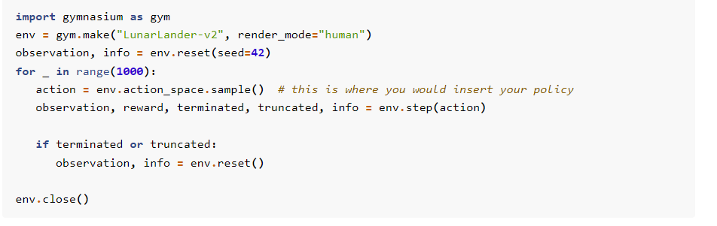
The environment env manages the update of the state and calculation of the reward. It knows in which state we are.
Gymnasium Documentation (farama.org)

Slide 19
Initial state
Gymnasium Documentation (farama.org)

Slide 20
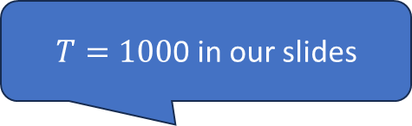
$T=100$0 in our slides
Gymnasium Documentation (farama.org)

Slide 21
env.action_space is the set of feasible actions
(state-dependent)
Gymnasium Documentation (farama.org)

Slide 22
Here we select a random move! (random policy, maximum exploration)
Gymnasium Documentation (farama.org)

Slide 23
Here we ask the environment to execute the action give the state we are in
Gymnasium Documentation (farama.org)

Slide 24
Here we ask the environment to execute the action give the state we are in (state is an environment variable)
Gymnasium Documentation (farama.org)

Slide 25
New state
Gymnasium Documentation (farama.org)

Slide 26
Tabular Q-Learning Code
I am going to provide you with a code that can guide your work.
Try to match the code against the slide contents
The code will not work as is, you need to figure out how to build the solution yourself, but it should make it clear what I exactly mean

Slide 27
Tabular Q-learning Code: Initialization
import numpy as np
class TabularQLearning:
def __init__(self, num_states, num_actions, learning_rate=0.1, discount_factor=0.9, epsilon=0.1):
self.num_states = num_states
self.num_actions = num_actions
self.learning_rate = learning_rate
self.discount_factor = discount_factor
self.epsilon = epsilon
self.q_table = np.zeros((num_states, num_actions))

Slide 28
Tabular Q-learning Code: Epsilon Greedy
def choose_action(self, state):
if np.random.rand() < self.epsilon:
return np.random.choice(self.num_actions)
else:
return np.argmax(self.q_table[state])

Slide 29
Tabular Q-learning Code: Q-learning Update
def update_q_table(self, state, action, reward, next_state):
old_q_value = self.q_table[state, action]
next_max = np.max(self.q_table[next_state])
new_q_value = old_q_value + self.learning_rate * (reward + self.discount_factor * next_max - old_q_value)
self.q_table[state, action] = new_q_value

Slide 30
Tabular Q-learning: Main Loop
# Simulated environment interactions
num_episodes = 1000
for episode in range(num_episodes):
state = np.random.randint(0, num_states) # Random initial state
while not done:
action = agent.choose_action(state)
# Simulate environment: obtain reward and next state
next_state, reward, done = env.step(action)
# Update Q-table based on the observed transition
agent.update_q_table(state, action, reward, next_state)
state = next_state
# YOUR KPI CALCULATIONS HERE TO PROVE AGENT IS LEARNING

Slide 31
Assignment
Any environment from Gymnasium or comparable libraries is acceptable.
The simplest environment is Frozen Lake, if you want to try it, please use the 8x8 version: Frozen Lake - Gymnasium Documentation (farama.org)
  You can solve this with a simple table.
Try out a deep network without vision with discrete actions
  (cart-pole)
  Classic Control - Gymnasium Documentation (farama.org)

Slide 32
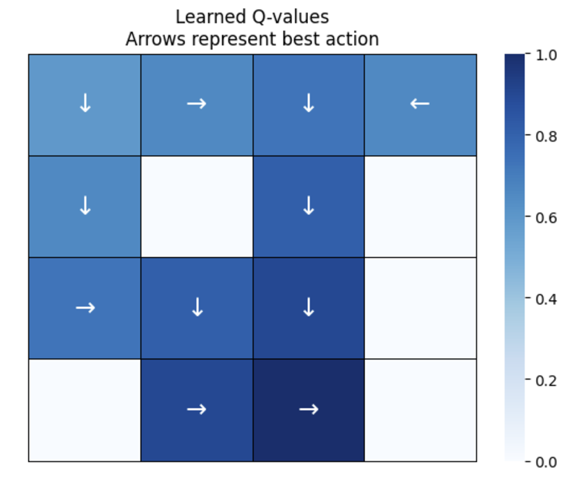
Plot and justify on agent behavior
Generate a Python function that takes a Q-table and map size, returns the maximum Q-values, and the best-learned actions mapped to arrows (←, ↓, →, ↑) on a grid.

Slide 33

The End

